Slide 1
Image Inpainting
The main objective is to implement the Deep Conditional GAN on image inpainting.
GAN incorporates two neural networks:
A generator – it takes in the incomplete image as the input and generates a fake full image with the missing segment filled.
A discriminator – it tries to distinguish generated images from original full images.
They will operate on min-max algorithm which have some loss function.

Slide 2
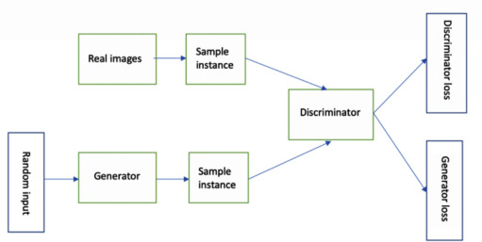

Slide 3
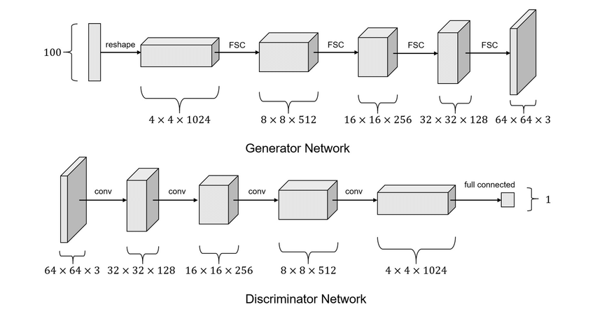

Slide 4
The encoding layers consist of different functions like ReLU activation function.
For our project, we will be using LeakyReLU – it has small slope for negative values instead of a flat slope.
Dataset
We will be using dataset by MIT Computer Science and Artificial Intelligence Laboratory.

